Slide 1
Team Adway
Sign Language Recognition
Member 1: Tej Pratap Yadav (7673883813) Member 2: Gaurav Rana (8351800245) Member 3: Vinay Kumar Chauhan (8949929742) Member 4: Aakansha Tejwani (8094036962)

Slide 2
Description of the Project
Problem Statement
Approach to the Solution
The deaf and dumb people use signs to convey messages and express themselves to others which requires both the parties involved in the communication process to know the meaning of that signs. We cannot expect everyone to know the meaning of different signs.
Using Neural Network we can build a model that recognises sign language and output in the form of another natural language such as English.
Relevance to the Theme
Techstack Involved
This Project is under the theme of Open Innovation.
This project is an instance to portray that the advancement in technoloy is for all.
Python language has been used. Famous deep learning library keras has been used to create nueral network.

Slide 3
Details of Technology Stack
Python is an interpreted, high-level and general-purpose programming language.
It is being widely used in the filed of Machine Learning and Deep Learning.
Python
Keras is an open-source software library that provides a Python interface for artificial neural networks. Keras acts as an interface for the TensorFlow library.
Keras
Description
Of
The same
Tech3
Description
Of
The same
Tech4

Slide 4
Description of the Solution
Step 1
Step 2
Initially we searched for the ways to develop the neural network. We came to know that CNNs are used for image classification.
In order to achieve a higher degree of accuracy CNNs become deeper and complex. So, we planned to use transfer learning and use MobileNet.
2021
Step 3
Step 4
As to train any kind of neural network a lot of data is needed. So we started preaparing dataset for our model.
Using those data we trained our model to predict the sign from the gesture of the hand.

Slide 5
Novelty of the Solution
In most of the cases we try to develop AI assistants which takes verbal instructions, this would take instructions in sign language. So, through this system any person having some or the other kind of speech problem he/she can use this system to express himself/herself to other people as well as to the computer, this system can act as a medium that converts sign to text. There are a lot of people who are either deaf or dumb or have some or the other kind of speech impairment, although there is a continuous development in the technology still if this technology is not helpful for those kinds of people than we collectively can not say that the technology is really advancing.

Slide 6
Growth Plan of the Product
10%
Collecting the Data. Capturing the images of our hands portraying a particular sign such as numbers and english alphabet.
Checkpoint 1
25%
Preparing a dataset from those images to be fed to the neural network.
Checkpoint 2
50%
Creating the Model and training it on this dataset.
Checkpoint 3
75%
Using this model to predict the new sign and classify it accordingly. Later this model can be used in the form of an android app.
Checkpoint 4

Slide 7
Business Aspects of the Hack
01
Market Impact
This project can open a new door to interact with the deaf and dumb people.
Target Consumers
02
Everyone who needs to interact with any person having difficulty in speech. A company can use it to understand this particular portion of their customers.
03
Financial Sustainability
How you plan on maintaining a stable finance model?
Product > Project
04
This model can be used in the form of an android app or even it can be integrated with chatbots.

Slide 8
Working Prototype
- Github Link

Slide 9
Learning Curve
What have you learnt by doing this project?
04
01
Growth 1
How Maths is being used in its simplest form to create AI.
03
02
Growth 2
02
Technology can be used for everyone.
01
03
Growth 3
Follow your Heart.
04
Growth 4
Always be grateful.

Slide 10
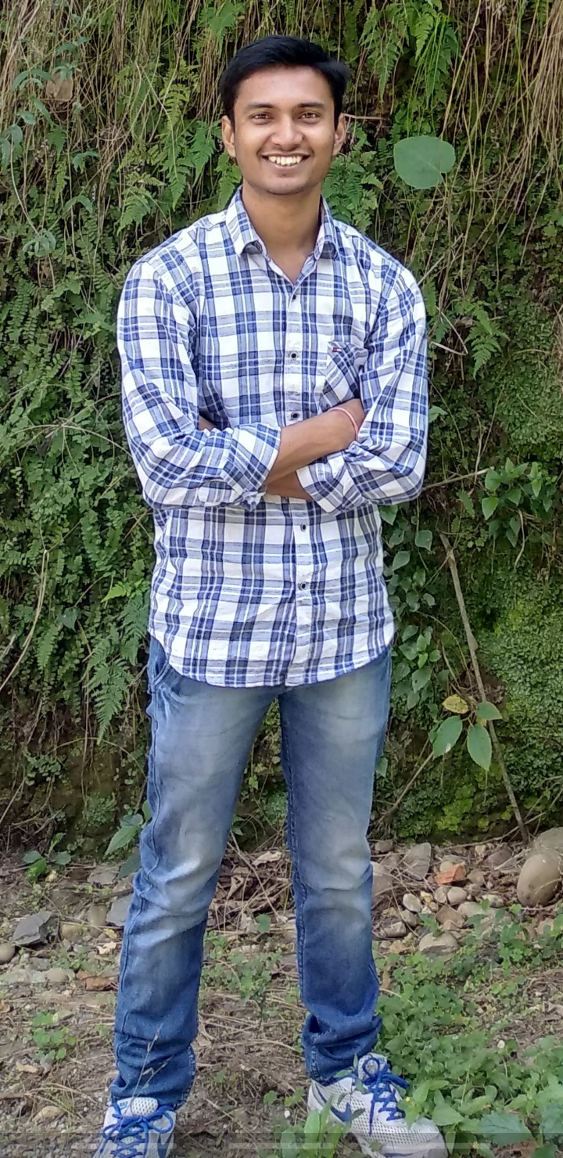

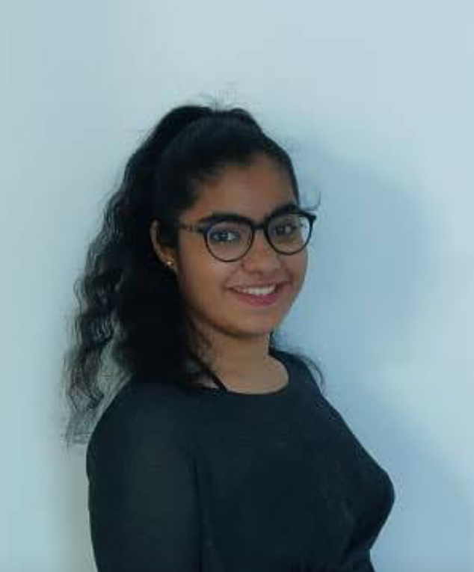
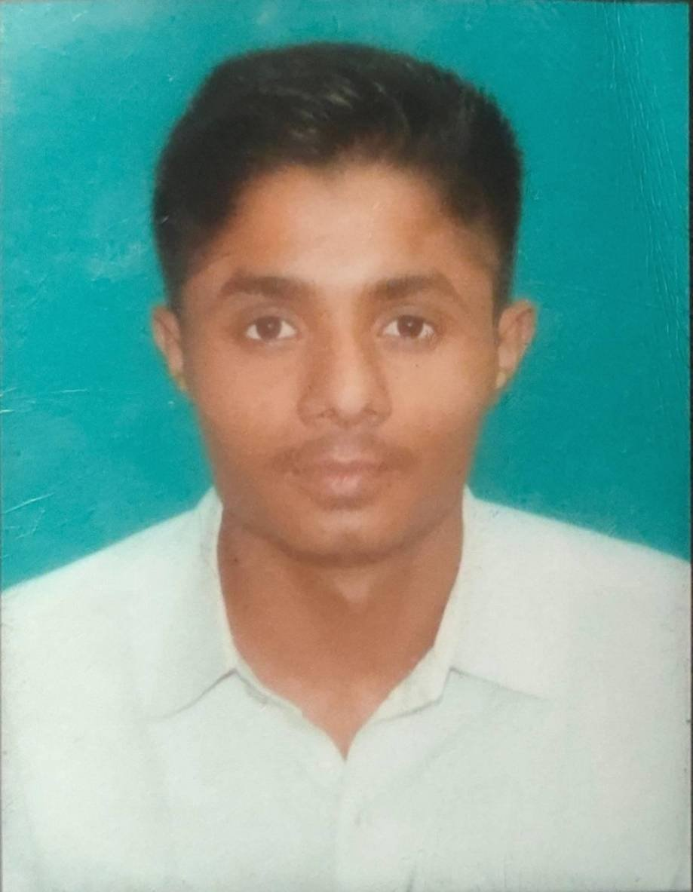
About Team
01
Member 1
02
Member 2
Tej Pratap Yadav
Gaurav Rana
03
Member 3
04
Member 4
Aakansha Tejwani
Vinay Kumar Chauhan

